Slide 1

Future Grocery Shopping
Dr. Mamoun Samaha

Slide 2


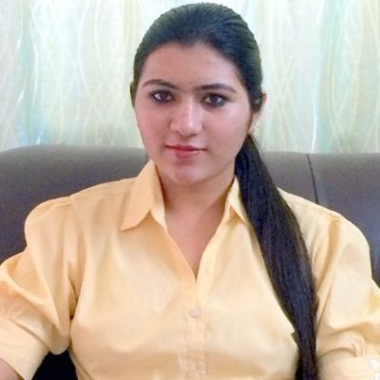

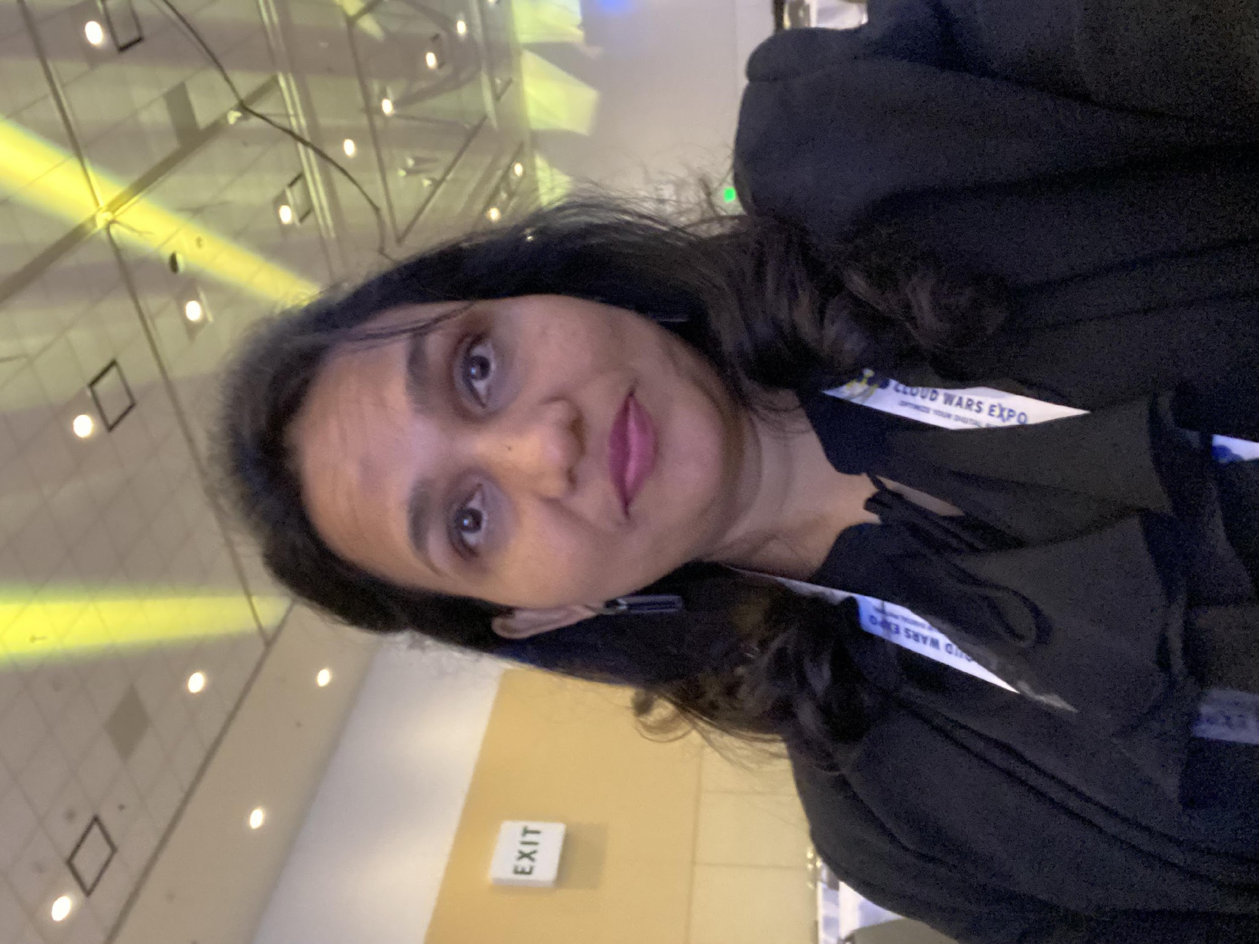
Group Members
Luman Yang Business Analytics
Savita Khadse Software Engineering
Sonal Pande Engineering Management
Kyiv Edwards MBA

Slide 3
 | Table of Content
1) | Introduction, Planning, Strategy and Operations | Sonal Pande
2) | Optimization | Kyiv Edwards
3) | Marketing Research & Financial Analysis | Luman Yang
4) | Website /App Demo | Savita Khadse

Slide 4


Goal
Just like Expedia is the largest platform to book air tickets without owning any aircrafts,
similarly, we want to be the largest grocery selling platform without have any grocery inventory!

Slide 5














Why Store Aggregation?
Elderly people.
People with special needs.
Busy working professionals.
Delivery partner
Store
Home
Mothers with younger kids.
Store aggregator app
Pandemic situation
People who have ‘Passion for life’

Slide 6
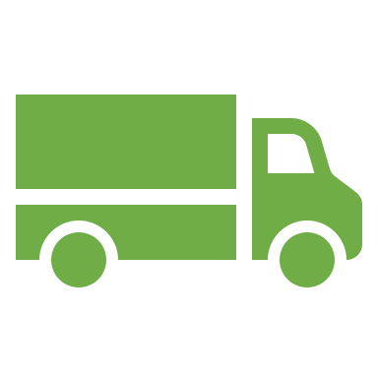


Operational Logic
Delivery Charges =
Delivery ETA =
Distance
Store
Customer
4-Wheeler
Time
Time
Delivery partner
Store
Store
Customer
Shock absorbing time

Slide 7
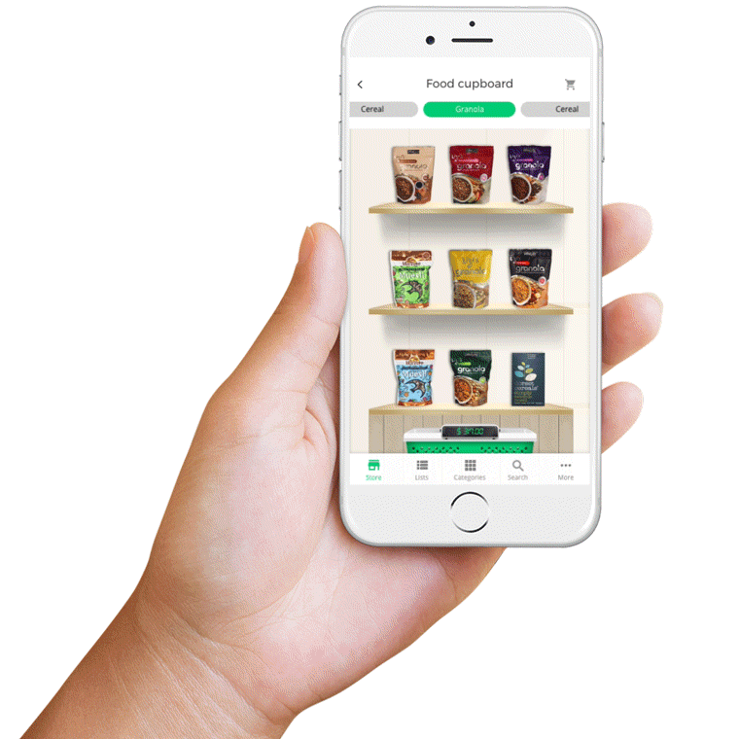

Our service Differentiation
1) Quickest possible delivery. 2) Select from your trusted stores.

Slide 8
Roadmap
Phase 1
1
Grocery store aggregation.
2
3
Phase 2
Phase 3
Cold chain products
Medical store aggregation

Slide 9

Strategy
Tag Line - ‘Passion for life’
Covid 19 ‘Newsjacking’
Porter’s 5 forces
SWOT Analysis
VRIN Test
Balance Score card
PESTEL Analysis

Slide 10
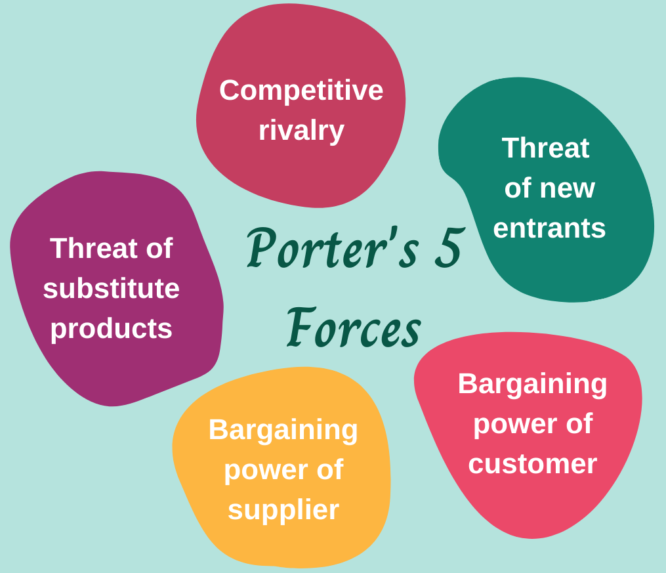
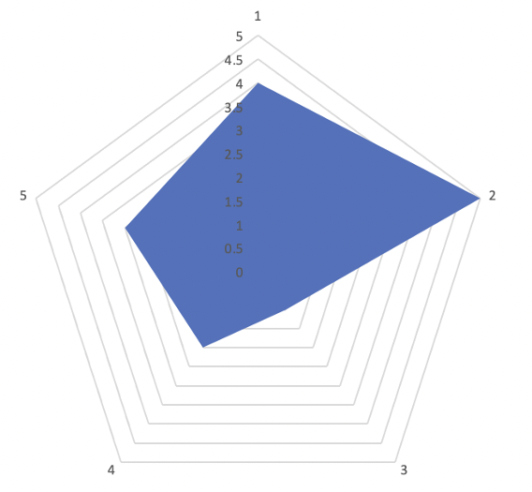
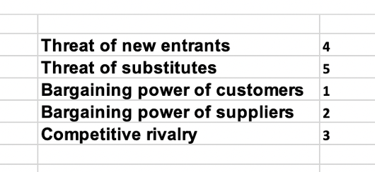

Slide 11
VRIN Test – To measure the most impactful factors in this industry.
Resource /Capability | Weightage | Is it valuable? | Is it rare? | Is it non- imitable? | Is it non- substitutable? | Points
Quality of service | 7 | Yes | Yes | No | No | 14
Brand Recognition | 5 | Yes | Yes | No | No | 10
Packaging | 4 | Yes | No | No | No | 4
Trained /expert staff | 3 | Yes | Yes | No | No | 6
Delivery time | 8 | Yes | Yes | Yes | Yes | 32
Rating | 2 | Yes | No | No | No | 2
Latest technology | 1 | Yes | No | No | No | 1
Differentiation | 6 | Yes | Yes | No | Yes | 18
 |  |  |  |  | Total | 87

Slide 12
Strengths
Weaknesses
Quickest grocery & medicine delivery service.
User friendly app.
Order from your (customer) trusted place.
Know the exact time of delivery
Change the time of delivery.
Location based store finder
Delivery charges applicable.
Order delays due to operational roadblocks
Customer switching cost is low.
Low brand awareness and marketing.
SWOT Analysis
SSWOT
Analysis
Opportunities
Threats
Pioneer in medicine delivery business
Exponentially growing market for online grocery and medicine.
Minimal competition in medicine delivery.
No market leader currently for medical section of our business.
Positive future scope.
Low customer base currently.
Unstable customer base.
Increasing heal consciousness (so people prefer walking).
Increasing potential competitions.
Laws and government regulations.

Slide 13
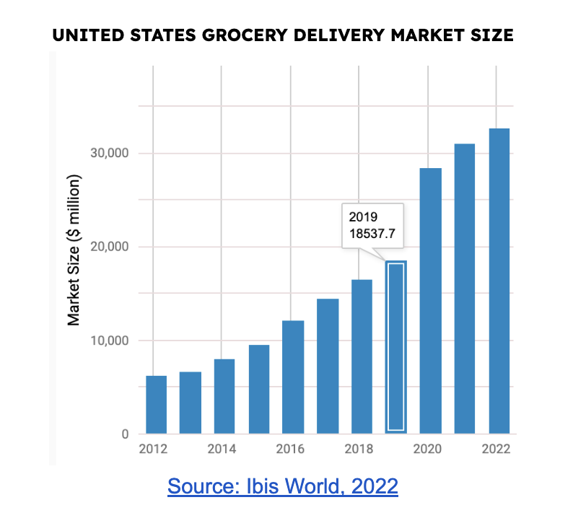
COVID-19 Propelled Online Grocery Delivery
The online grocery delivery market saw steady growth in adoption during the 2010s, which was amplified by the COVID-19 pandemic’s strict lockdowns.
2020 lockdowns saw a 53% annualized growth
rate within the online grocery delivery market
Consumers have grown accustomed to the convenience
and reduced stress of grocery delivery
Store owners are eager to diversify their consumer base
and keep their business technology up-to-date
The global grocery delivery market is expected to grow
at a CAGR of 25.3% over the next 8 years
Kyiv Edwards

Slide 14










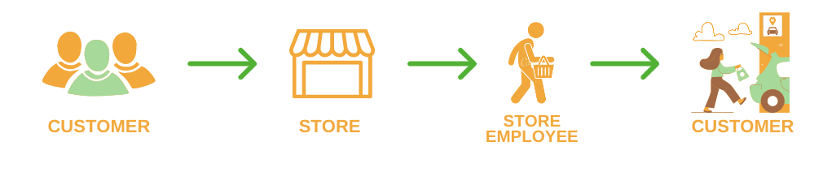



Forging a competitive advantage
We analyzed the market’s business models to discover untapped opportunity for penetration.
MODEL 1
Marketplace connecting stores and consumers with independently contracted delivery persons
MODEL 2
Big Box retailers utilizing economies of scale to provide same-day delivery to customers
MODEL 3
Online platforms offering same-day delivery from their fulfilment centers
MODEL 4
Grocery stores offering in-store and curbside pickup through their websites (larger stores) or through email requests (smaller stores)
OPPORTUNITY
Provide a delivery service for consumers looking to collect orders from multiple stores, utilizing existing in-store and/or curbside pickup capability.
Kyiv Edwards

Slide 15
Focus on efficient and quality service
We must ensure that we are optimizing our operations to reduce delivery times and travel distance, while upholding the highest standard of quality.
OPTIMIZATION FACTOR
INTENDED OUTCOME
PRICE | Distance-based delivery fees for small orders Size and weight factored in for large orders | Competitive delivery pricing for smaller items
QUALITY | Virtual training modules to achieve “preferred driver” status Performance-based incentives for drivers | Emphasis on customer service, attention to detail, cleanliness, etc.
TIMING | Reduced fees to encourage off-peak hour delivery Provide incentives rewarding driver timeliness Optimize driver routes based on pickup time and location | Demand smoothing A culture of driver punctuality Efficient delivery routes
COST | Online marketplace model negates the requirement for property, plant, and equipment (PPE) costs | Reduced barrier of entry Greater investment in software and driver development
SUSTAINABILITY | Match order sizes to appropriate delivery methods Encourage use of reusable bags for delivery | Reduced emissions and wastage Reduce plastic waste
Kyiv Edwards

Slide 16
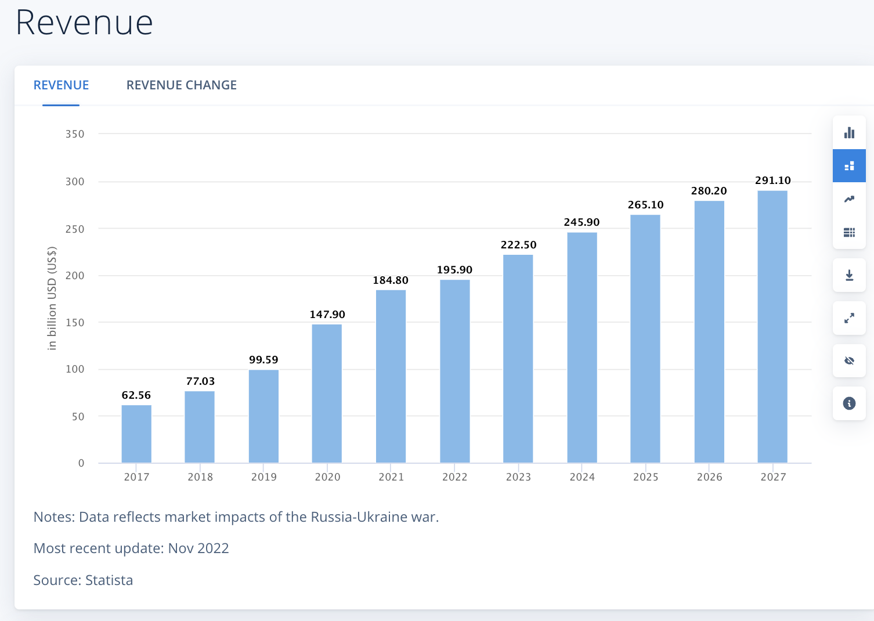
Industry
Overview
The average revenue per user (ARPU) is expected to amount to US$182.70.
Revenue is expected to show an annual growth rate of 8.24%, resulting in a projected market volume of US$291.10bn by 2027.
Luman Yang
Notes:
https://www.statista.com/outlook/dmo/eservices/online-food-delivery/platform-to-consumer-delivery/united-states

Slide 17

Target Market Size Projection
Older adults are the fastest growing age group in the world.
Nearly 30% of San Francisco residents will be age 60 or older by 2030 in San Francisco.
Percentage of older adults in San Francisco by year 2020: 23%
California Counties by Percentage Increase of Elderly Population Aged 60 and Over, Years 2010 - 2060 159.36%
Challenge
poverty
Housing
Income source
social isolation
Rising Home Care Cost
source:www.sfhsa.org/about/reports-publications/older-adults-san-francisco
Luman Yang
Notes:
https://www.sfhsa.org/about/reports-publications/older-adults-san-francisco#:~:text=Growing%20Population&text=Nearly%2030%25%20of%20San%20Francisco,2020%3A%2023%25

Slide 18

Target Market Size Projection
One in ten San Franciscans reports a disability. Almost half of the people with disabilities are under age 65.
Mobility (Difficulty walking or climbing stairs): 49,773
Independent Living (Difficulty doing errands alone): 43,128
Personal Care (Difficulty dressing or bathing): 24,592
Challenge:
Housing
Home Care
Transportation
Safety
Souce: https://www.sfhsa.org/about/reports-publications/disability-san-francisco
Luman Yang

Slide 19
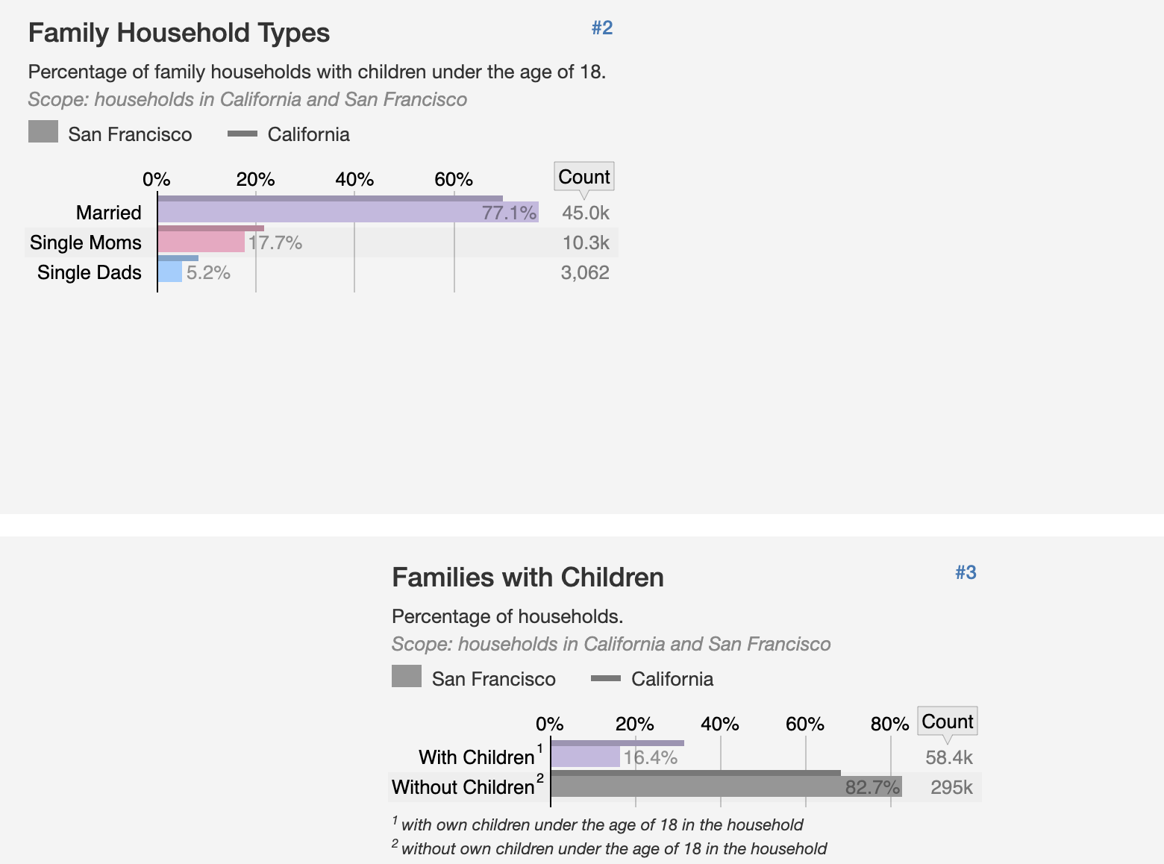

Market Size Projection
77% of population in SF,
About 45000 people is married
17.7% is Single Mom
5.25 is Single Dad
16.4% of SF households have children at home,
However, majority of households does not have children
https://statisticalatlas.com/place/California/San-Francisco/Household-Types
Luman Yang

Slide 20


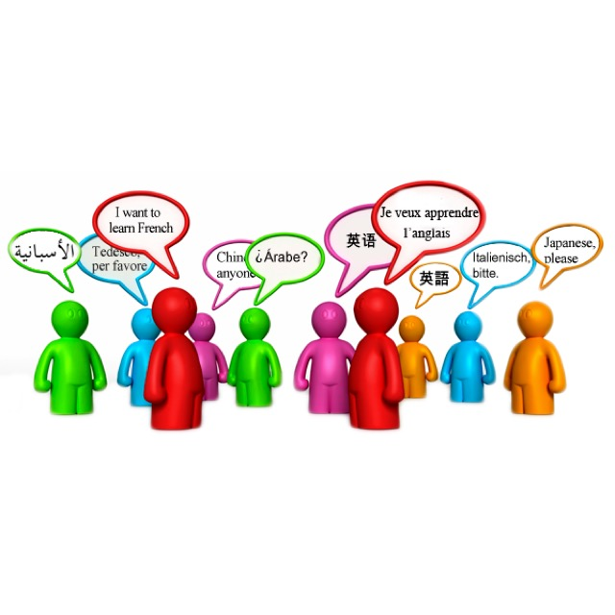

Market Communication Strategy
The 3 target customer segment which is a niche marketing, we can promote services to a small, specific and well-defined audience.
We will imply both traditional and digital marketing media for reaching our target audiences.
Social Media
Word of Mouth
Mail Ads
Email
Luman Yang

Slide 21

Revenue Source:
Customers: By Daily Transaction/ membership subscriptions
Store : By partnership contract
Government Funding: By collaborating with community service organizations.
E-retailer/ Small Business Owner: By Discount Bulk Deals
Luman Yang

Slide 22

Cost of good sold :
Application monitoring costs
Marketing expense
Software license fees
Website development and support costs
Professional services and training costs
Luman Yang

Slide 23




Financial Goal
Completely covered service in the bay area.
Develop 20 stores partnerships
Achieve 80 % of gross margins in 2024.
Provide returns to shareholders.
Revenue of $ 0.5 Million in 2023.
Luman Yang

Slide 24
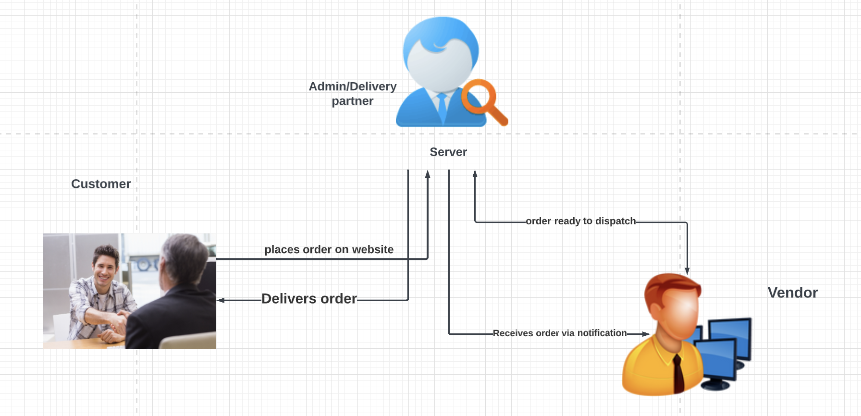
E-Commerce website basic scenario
By Savita Khadse
Notes:
When you log into django based website you open the login page so it happens because the view will process the request and it sends again to the login page url and then the response is sent from a server to the browser after that you will enter the credentials in the template and the data sent back to the view to rectify the request and then the data is presented in the model. Model verifies the data provided by the user in the connected database so if the user’s data matches it sends related data such as profile name , image and so on to the views if the data doesn’t match the model passes the negative results to the views. So that’s how django MTV architecture works.
In this project, we are the admin who is responsible for creating categories, change status once received notification from vendor on admin page notifying delivery partner and updating status so vendor and customer gets notified automatically on their homepage.

Slide 25
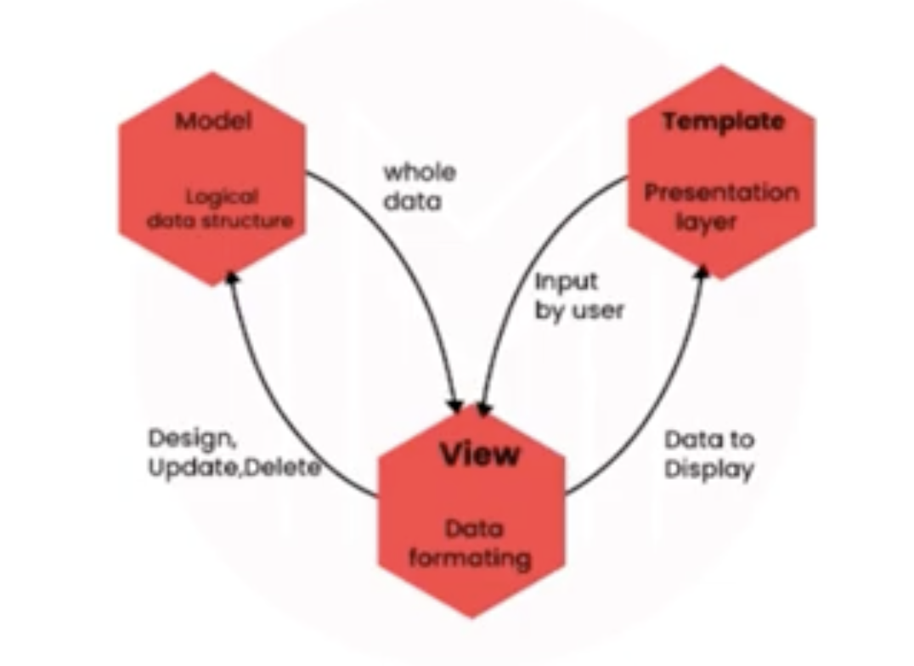
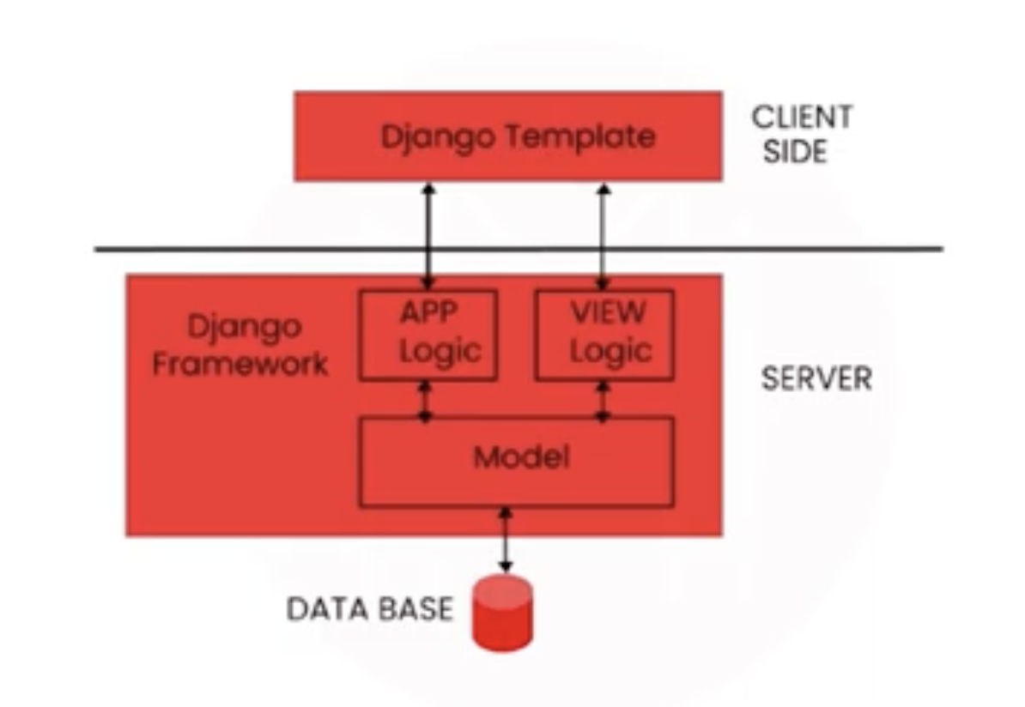
Django architecture
Model- Logical data structure behind the entire web application
Template- Presentation layer deals with presentation of the data
View- User interface which is what customer sees when to visit a website using url which is represented by HTML css and javascript files
Diagram source: www.google.com
By Savita Khadse
Notes:
Architecture:
Django follows Model Template view or MTV architecture.
Model- Logical data structure behind the entire web application
Template- Presentation layer deals with presentation of the data
View- User interface which is what customer sees when to visit a website using url which is represented by HTML css and javascript files
From the diagram You can see the template is on the client side which is basically HTML CSS and both the model and view are on the server side. So django uses request and response objects to communicate between the client and the server. So if the website receives the request it is transmitted from the browser to the server to manage the view file using a template. So after the sending correct url request the app logic and model initiate the right response to the presented request so after that the detailed response is sent back to you to check the response and transmit it as an http response or the desired user format. So then again it passes to the browser via the templates so to explain this more clearly I will show you a real life example.

Slide 26
Technological stack
Frontend The front-end is the HTML, CSS, and JavaScript that controls how this data looks on a webpage.
-HTML
-CSS
-Javascript
(reference:https://www.youtube.com/watch?v=lCCN_lkl3Xw&t=31s
https://nullphp.net/assets/posdash-html-admin-template/ )
Serverside
-Django-web framework
-Python -programming language to design views
Backend
The back-end is where the underlying database and any related logic lives
-MySQL database
By Savita Khadse

Slide 27
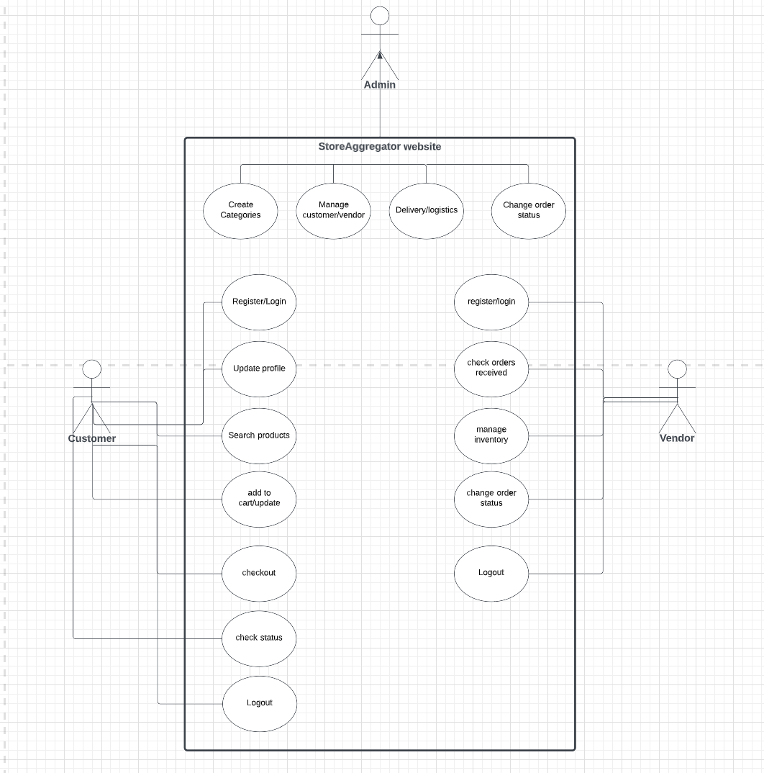
Use case Diagram
By Savita Khadse
By Savita Khadse

Slide 28
Prerequisites
Django project folder installation before running server:
>> pipenv install django - to install django in the environment
>> pipenv shell - to activate environment
>> pip3 install pymysql (change database name and root password, open mysqlworkbench)
>> pip install djangorestframework
>> pipenv install googlemaps
include the django_google_maps app in your settings.py
Add your Google Maps API Key in your settings.py as GOOGLE_MAPS_API_KEY
>> python manage.py makemigrations
>> python manage.py migrate
>> python manage.py runserver
To create superuser/admin:
Command- python manage.py createsuperuser
Username: admin
Email address: test@gmail.com
password:admin
By Savita Khadse

Slide 29
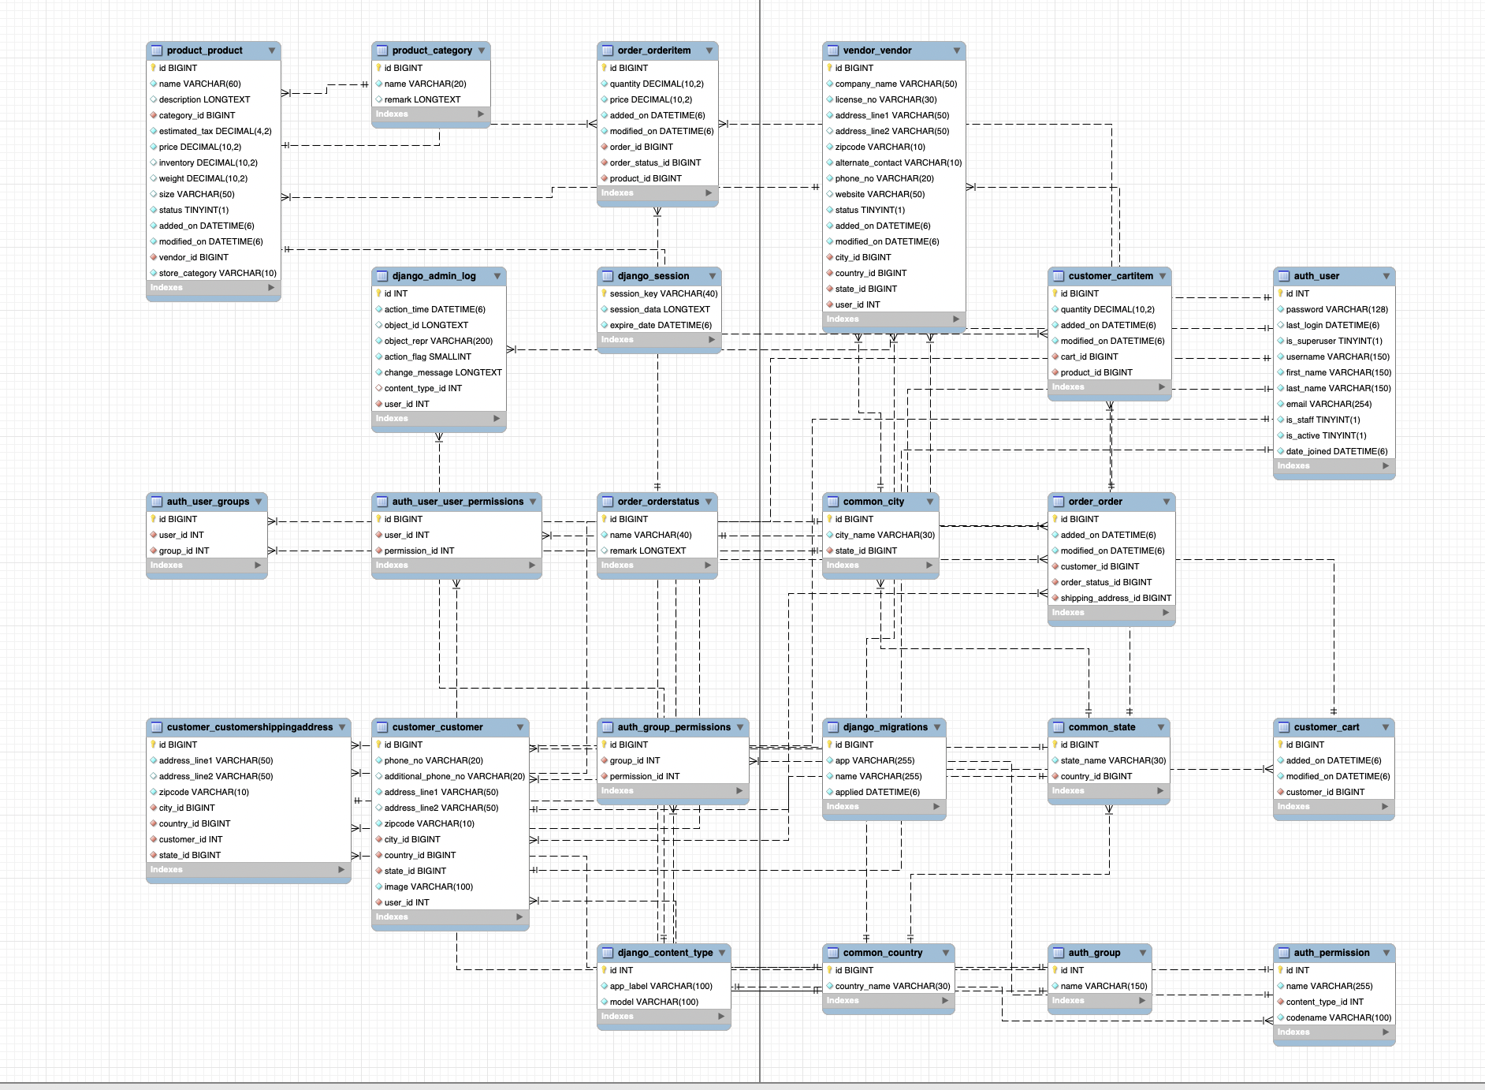
Entity Relationship diagram
By Savita Khadse

Slide 30
Features:
-Compared to other open source technologies, django offers excellent documentation in the market so it is the only framework which is helpful in solving any problem associated with the app development.
-Django is SEO (Search Engine Optimization)optimized, scalable and can flexibly switch from small to large scale projects
-Versatile in nature: it allows you to develop applications for various types of domains. It has vast community to connect with and share
-Rapid development
Reusability:One of the advantages of the Django app is reusability. Django is a combination of applications so copying those apps from one directory to another with some tweaks of the setting.py file won't need much time to write new applications from scratch. So because of this Django is the rapid development framework and this kind of code reusability is not allowed in any other frameworks.
Advantages:
Compatible with major operating systems and databases.
Supports MVC paradigm
Provides better CDN(content delivery network) connectivity and content management
Designed as batteries included framework
Provides JSON field support for all the database backends
Admin layout
Path libraries
Code Reusability
By Savita Khadse

Slide 31
Future scope
-Two step verification for registration
-Designing more views for customer and vendor module for more options
-Refining frontend designing for more attractive appearance
-Vendors dashboard to show his sale, profit and patterns
-Include AI algorithms to get patterns of purchase of products
By Savita Khadse

Slide 32
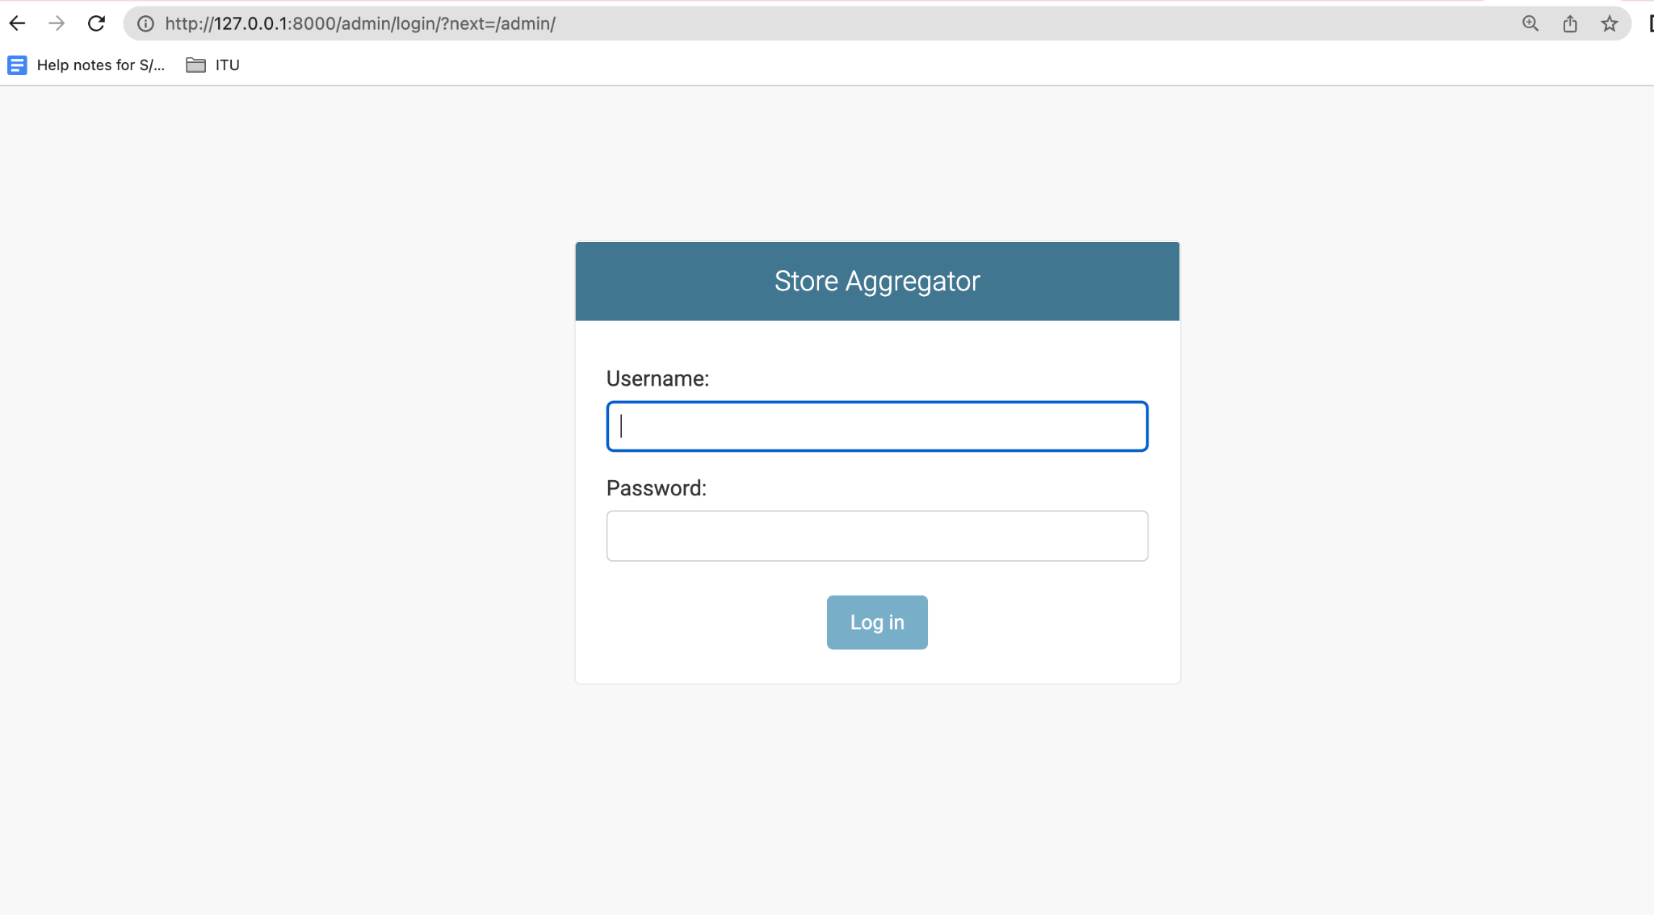
By Savita Khadse

Slide 33
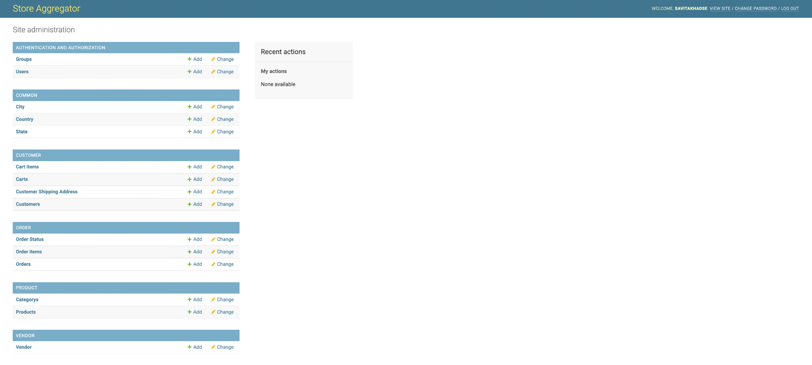
Categories section will be handled by admin
By Savita Khadse

Slide 34
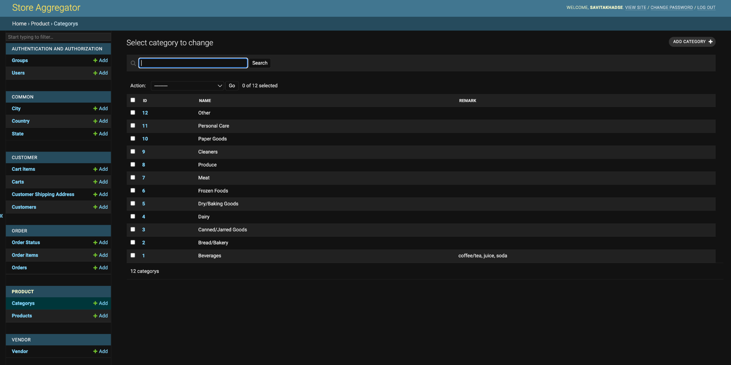
By Savita Khadse
By Savita Khadse

Slide 35
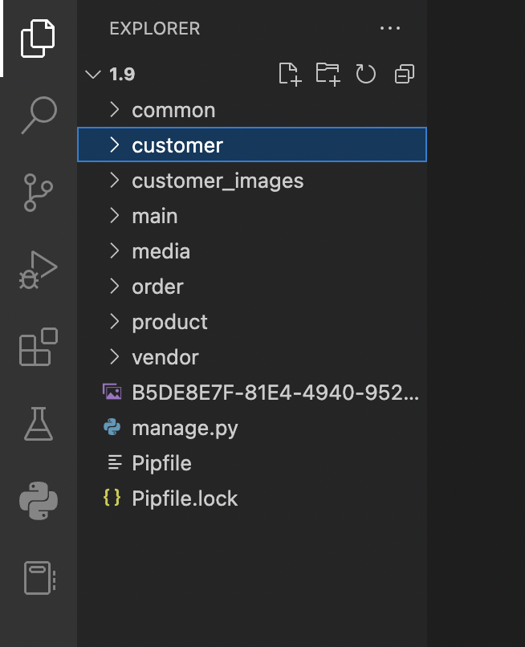
By Savita Khadse

Slide 36
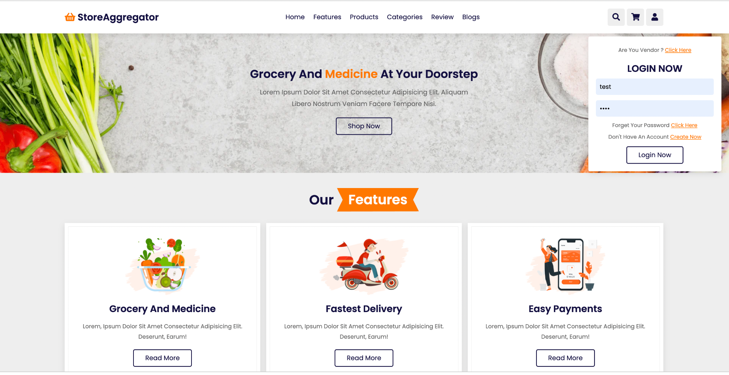
Before login homepage…..
By Savita Khadse

Slide 37
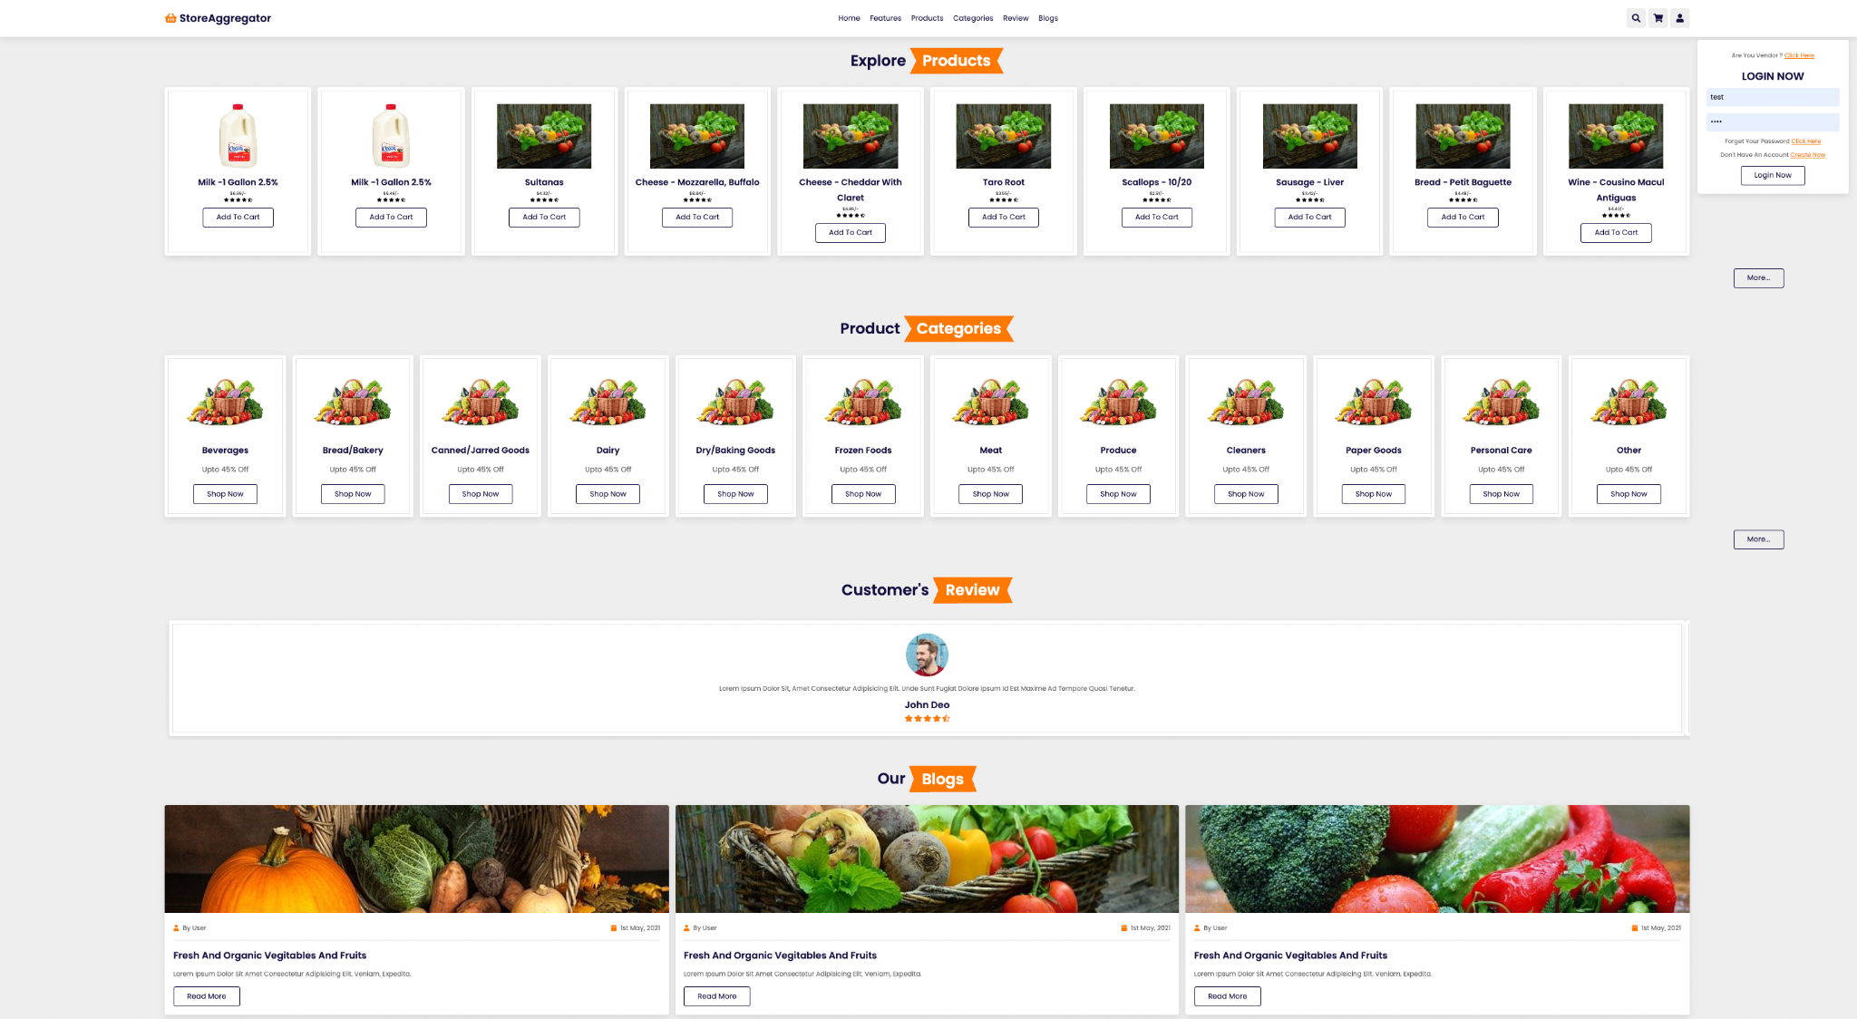
Before login products on homepage….
By Savita Khadse

Slide 38
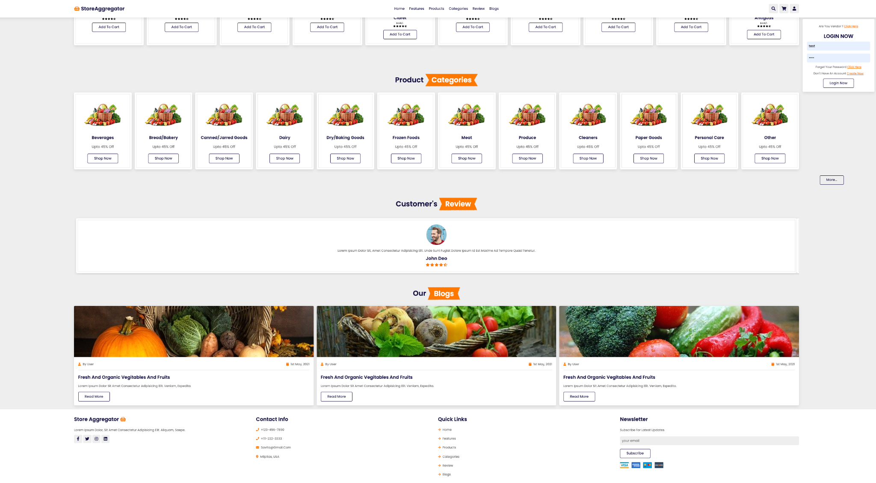
Before login products on homepage….
By Savita Khadse

Slide 39
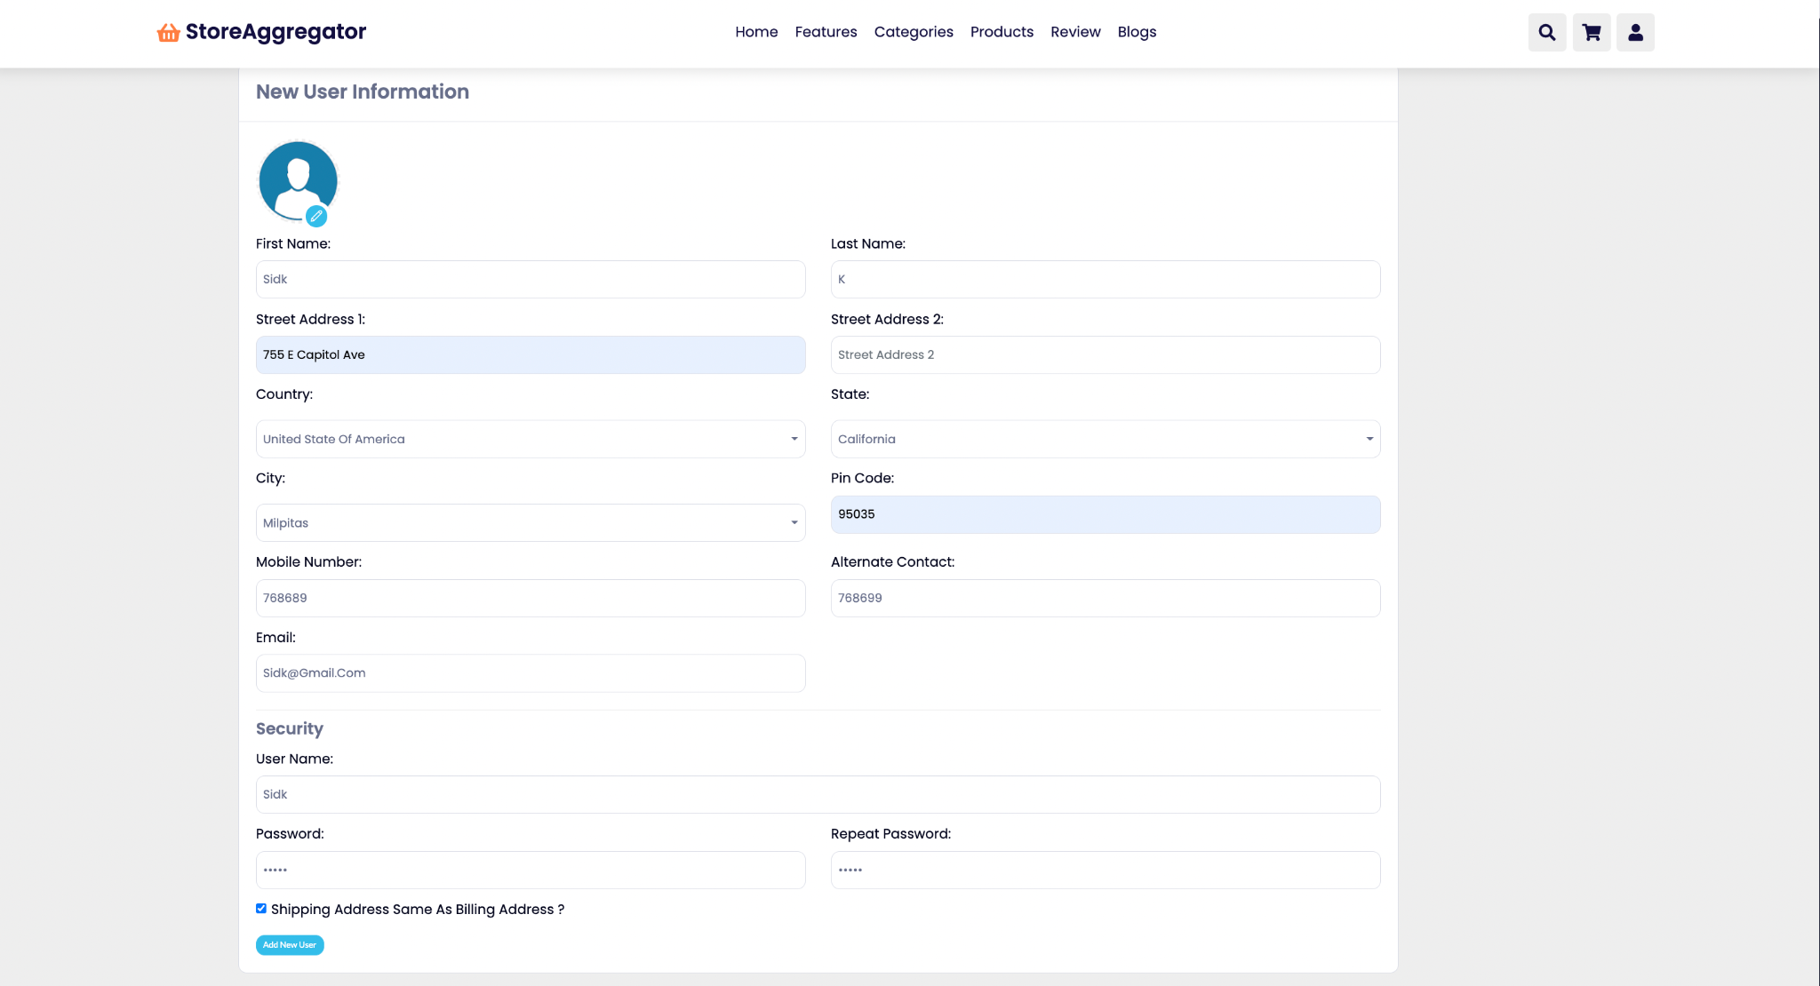
By Savita Khadse

Slide 40
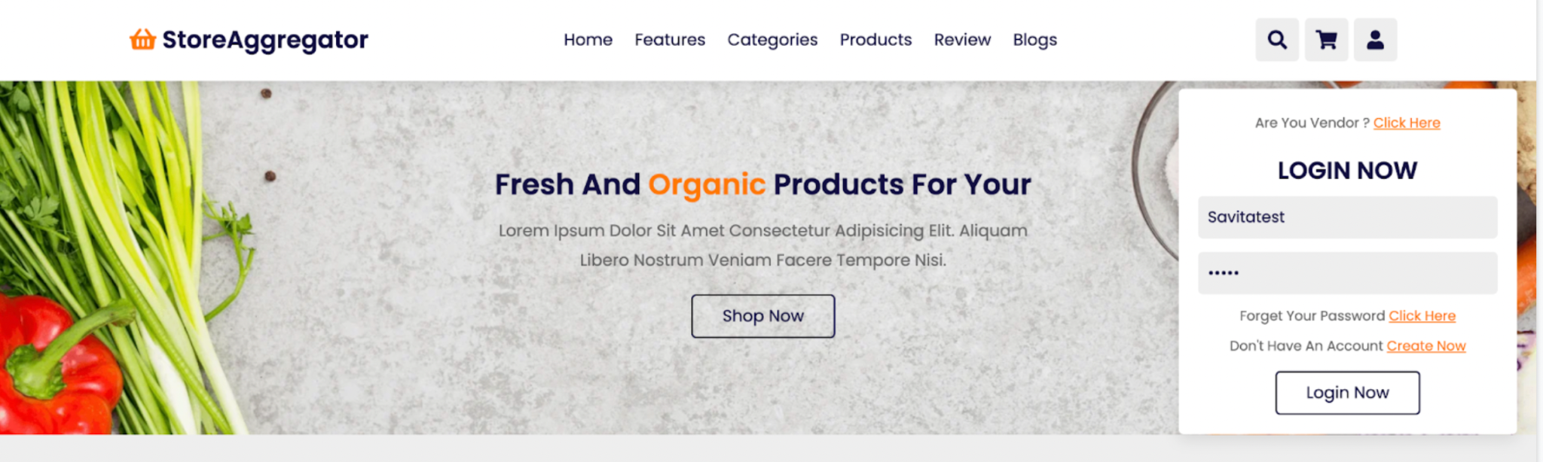
For Vendor login click “Are you vendor? Click here”
By Savita Khadse

Slide 41
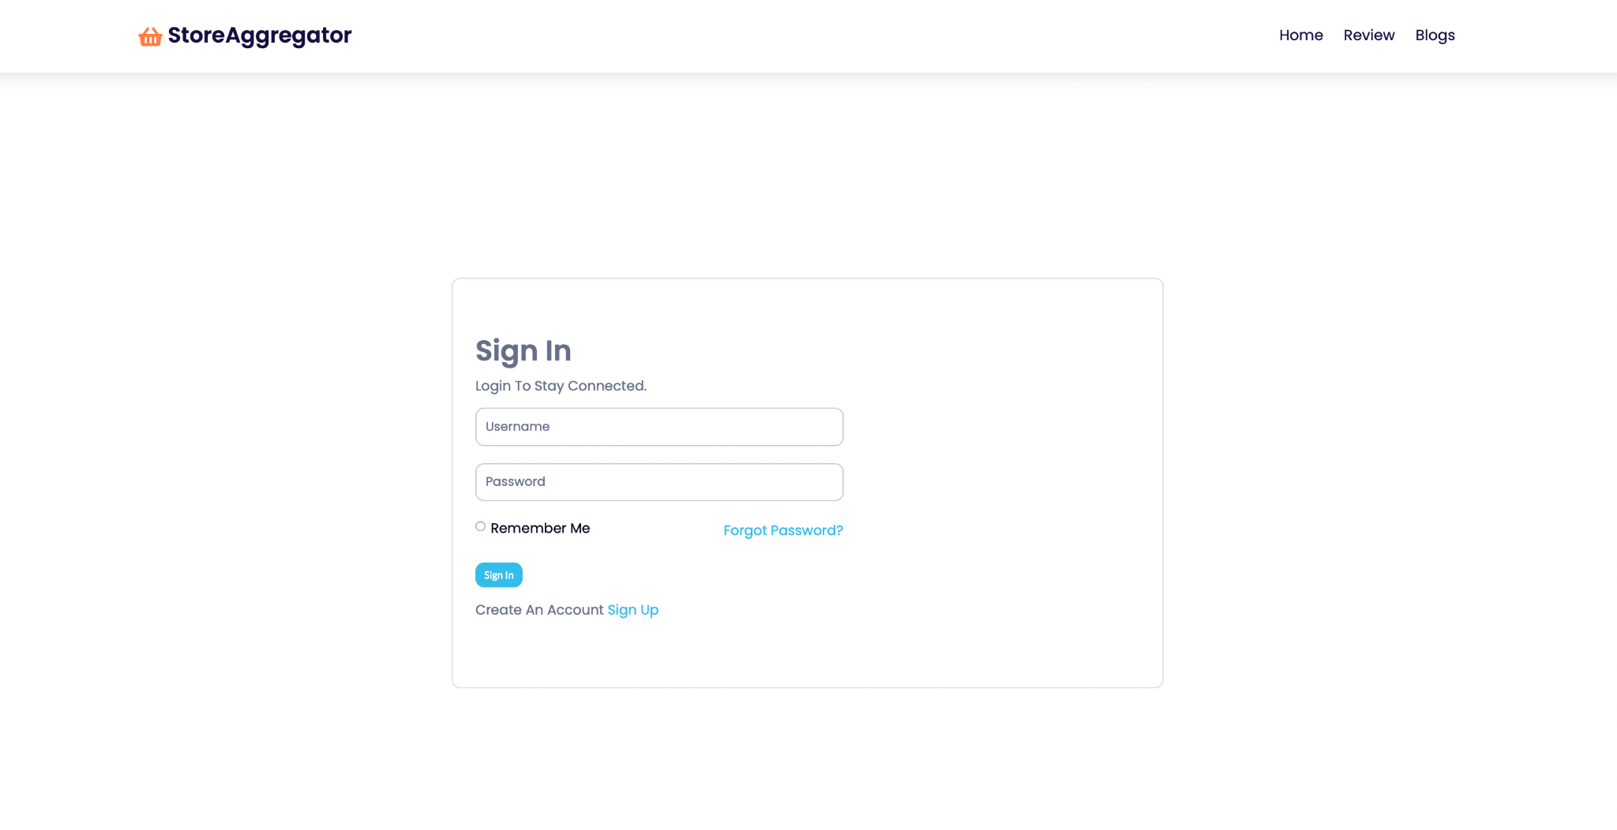
Vendor sign-in/sign-up page
By Savita Khadse

Slide 42
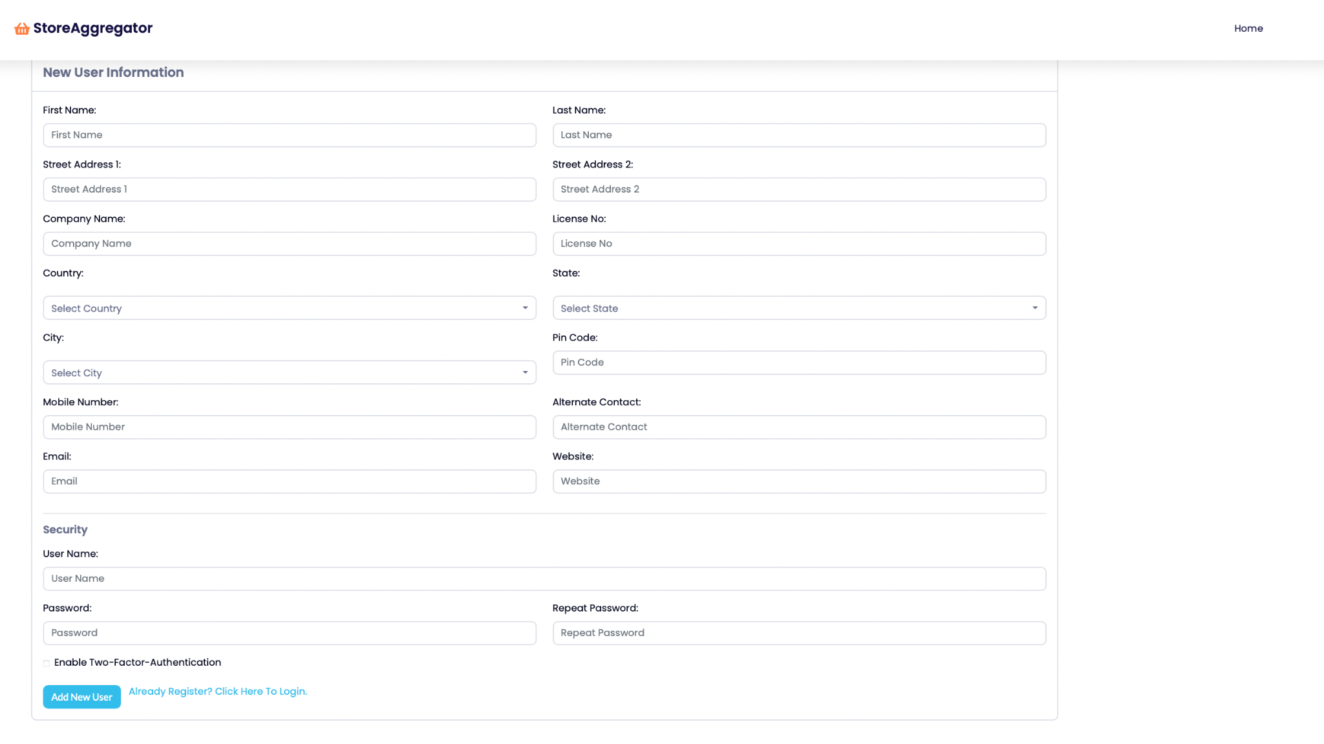
Vendor’s Registration page
If you already registered click here
By Savita Khadse

Slide 43
Vendors Login page
By Savita Khadse

Slide 44
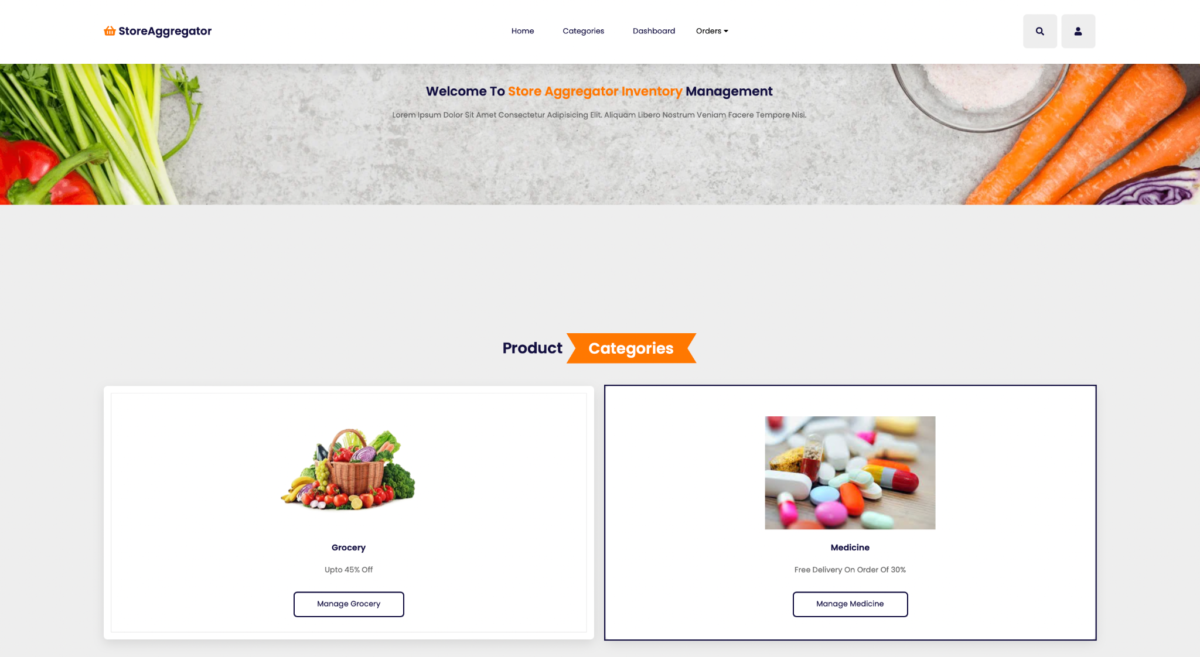
Vendor’s homepage
By Savita Khadse

Slide 45
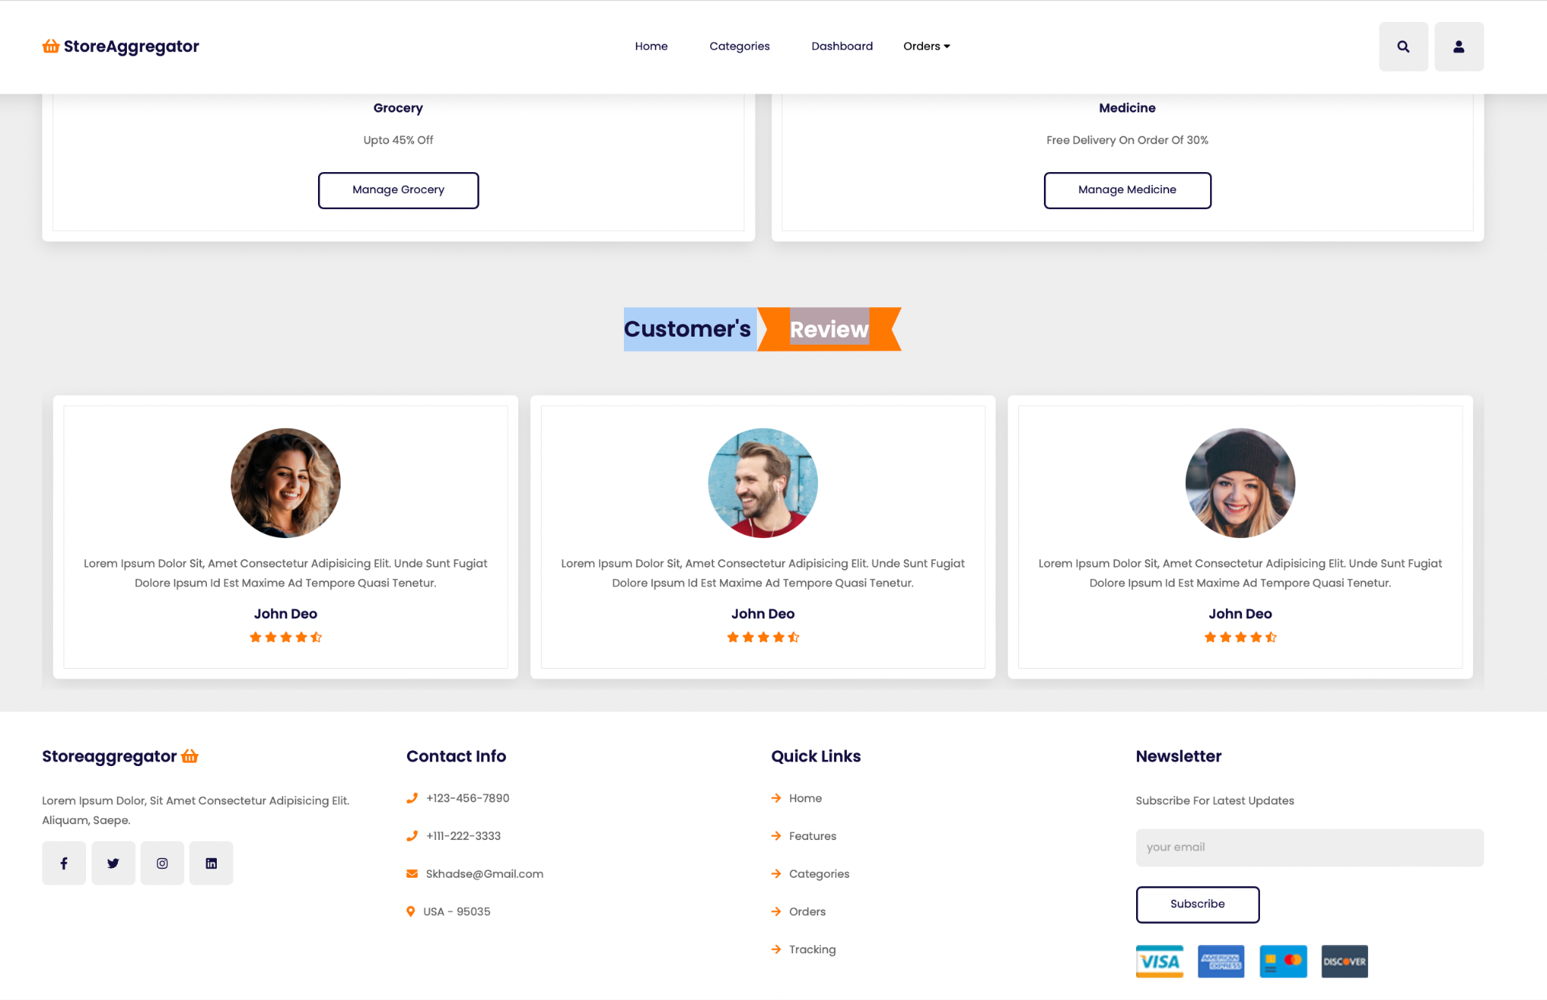
Vendor’s homepage continued….
By Savita Khadse

Slide 46
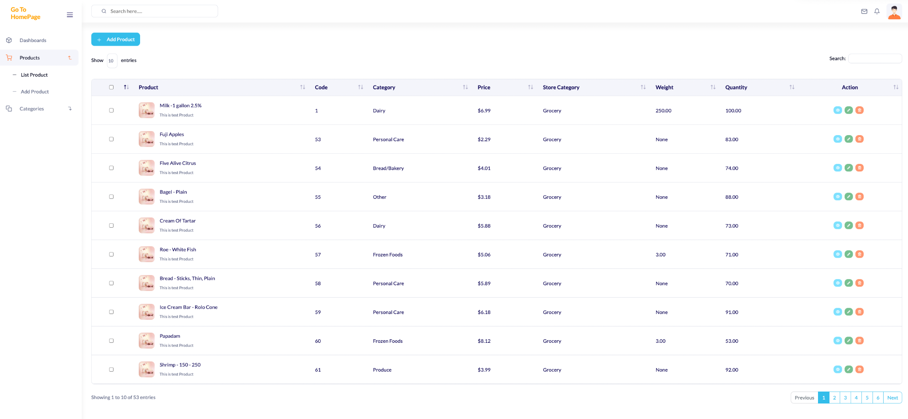
Vendors manage grocery page
By Savita Khadse

Slide 47
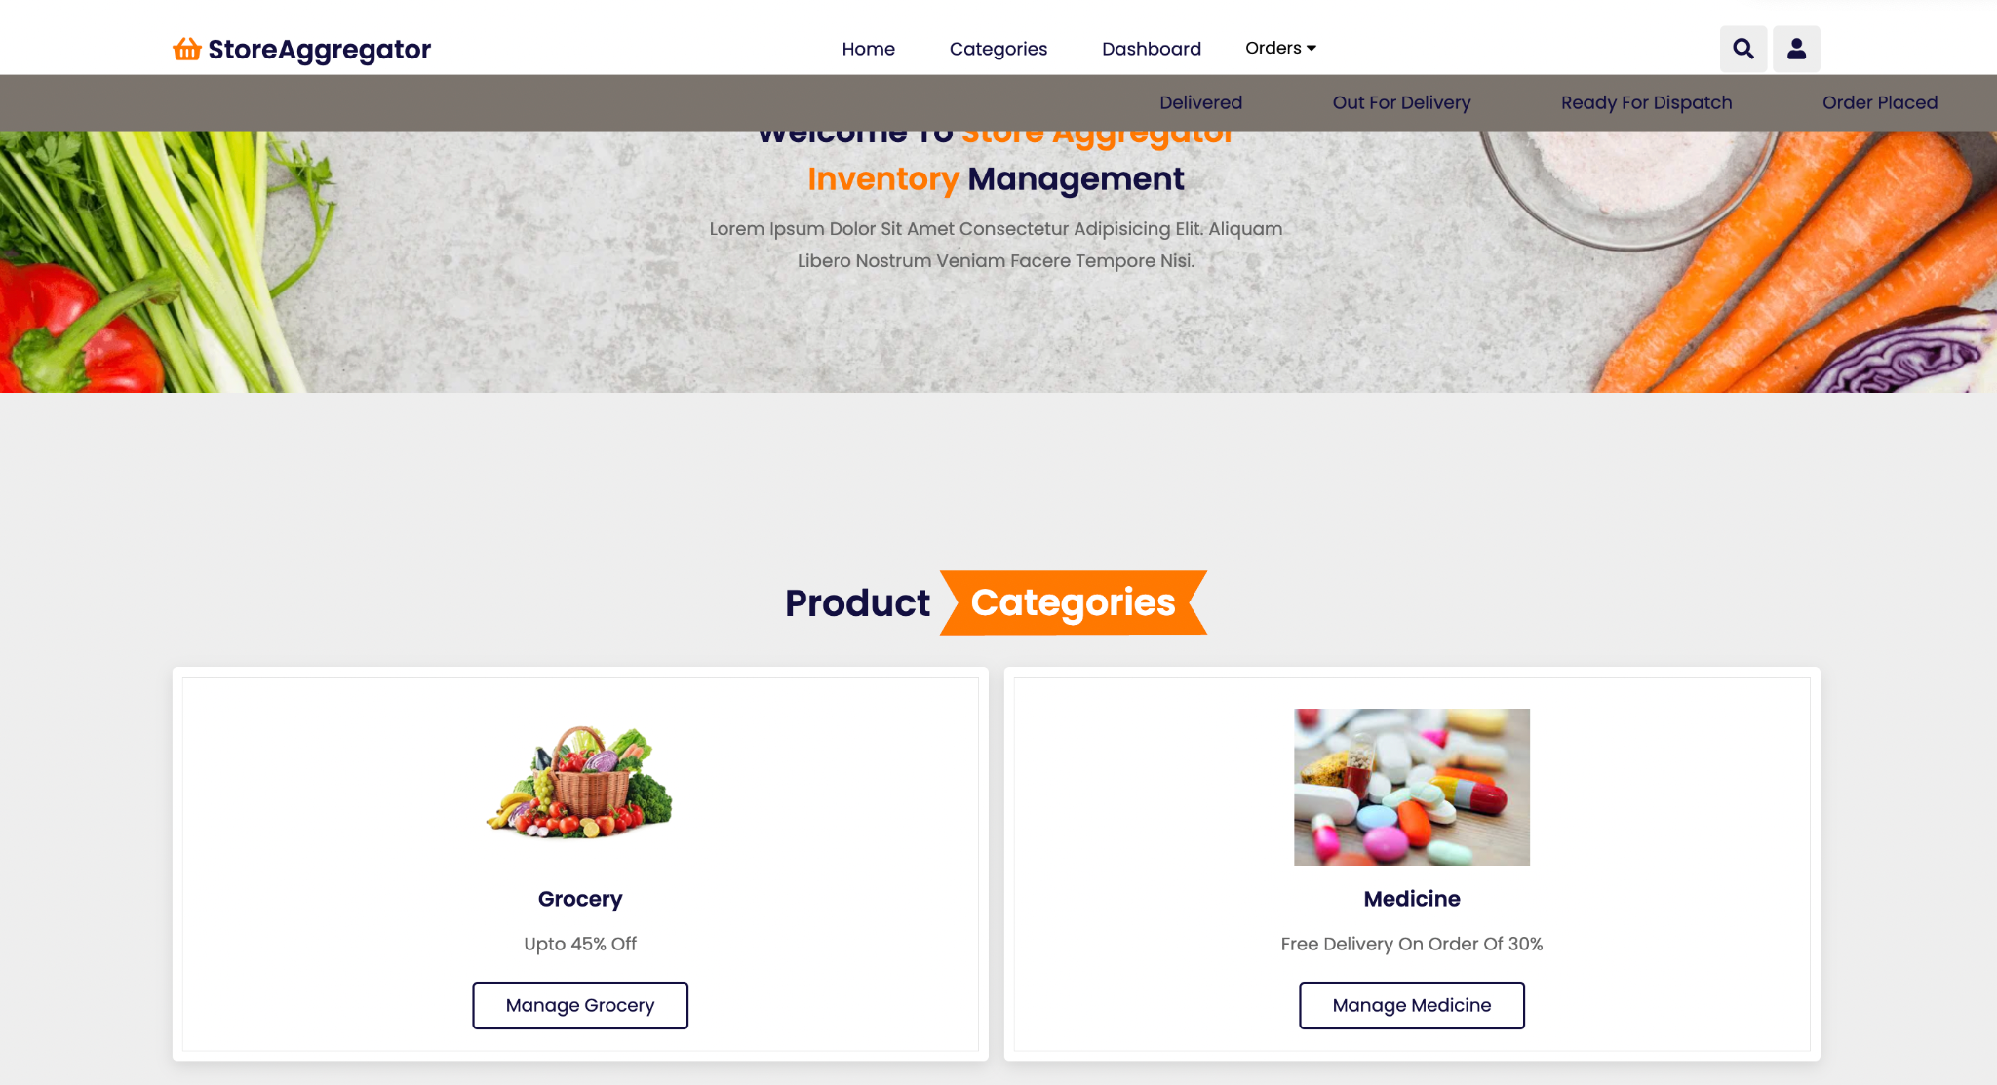
Vendor order page- To check order’s status
By Savita Khadse

Slide 48
References
https://docs.djangoproject.com/
www.codewithmosh.com
https://nullphp.net/assets/posdash-html-admin-template/
https://www.youtube.com/watch?v=lCCN_lkl3Xw&t=31s
https://www.statista.com/outlook/dmo/eservices/online-food-delivery/platform-to-consumer-delivery/united-states
https://www.sfhsa.org/about/reports-publications/older-adults-san-francisco#:~:text=Growing%20Population&text=Nearly%2030%25%20of%20San%20Francisco,2020%3A%2023%25
https://www.sfhsa.org/about/reports-publications/disability-san-francisco
https://statisticalatlas.com/place/California/San-Francisco/Household-Types

